Slide 1
Data acquisition and data wrangling
by Vishnu S

Slide 2
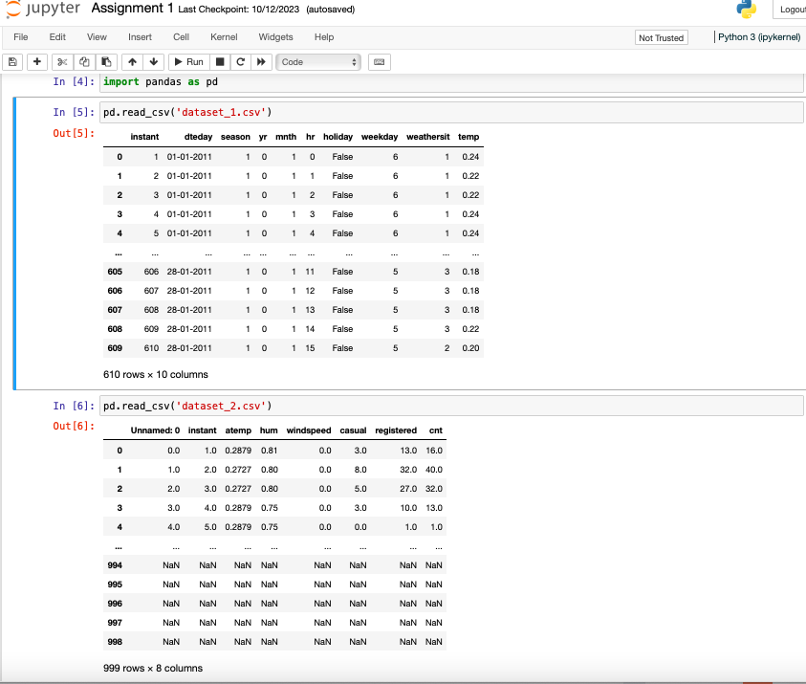
Import - data sets 1 and data sets 2
Using pandas library

Slide 3
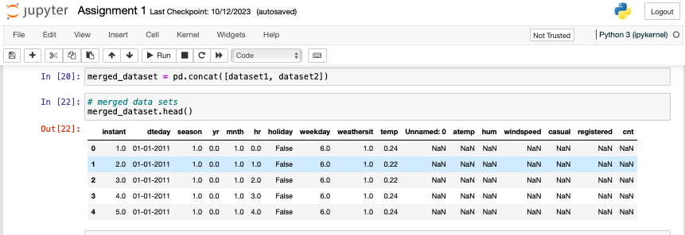
Merged the data sets
merged the data set 1 and data set 2

Slide 4
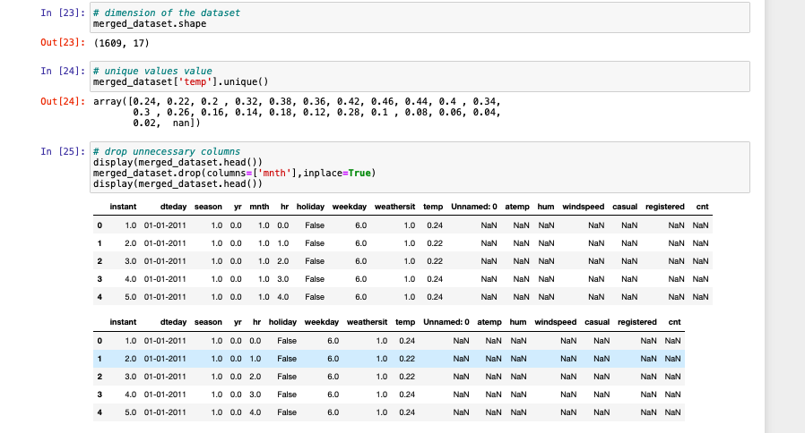
Dimension, unique values and drop functions
to check the rows and cloumns
to check the unique values of particular column

Slide 5
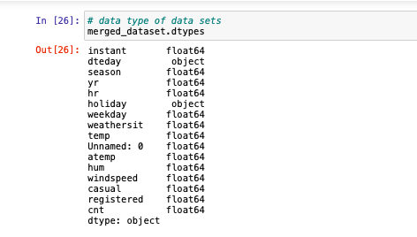
Data types
to check the data types of the data set, whether its integer, float or character

Slide 6
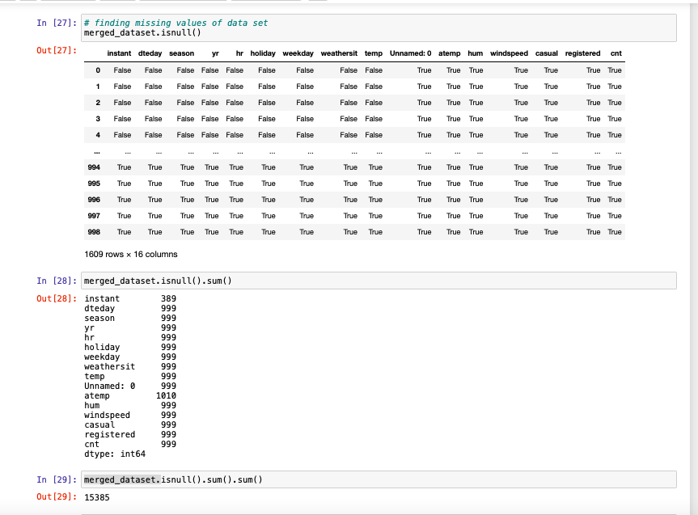
Missing values
to find out the missing values of the dataset

Slide 7
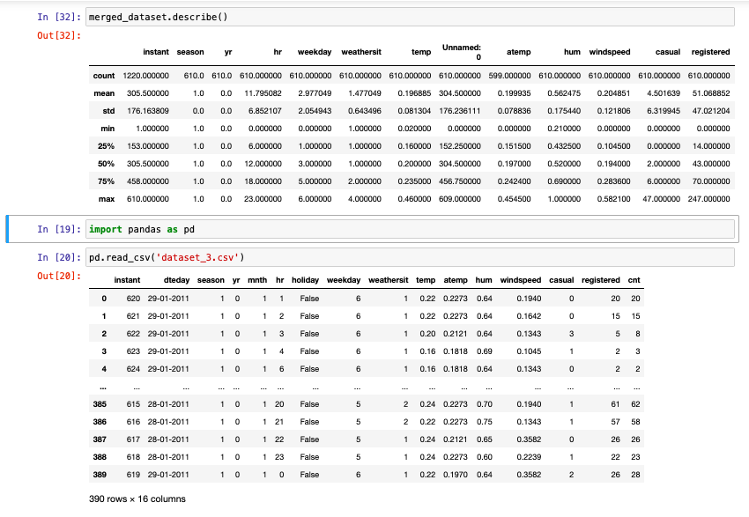
Datatype summary
to find the mean,median and mode of the particular data set, using describe function

Slide 8
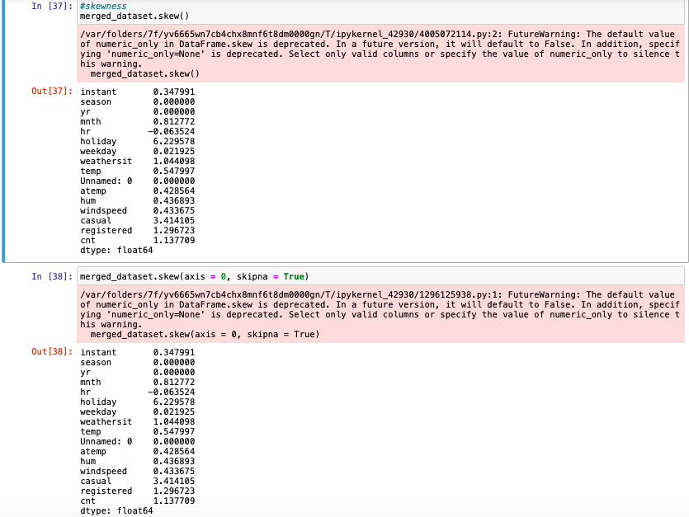
skewness
to find the skewness of the data sets, as bell shaped curve whether its positive, negative or no skewness is happen

Slide 9
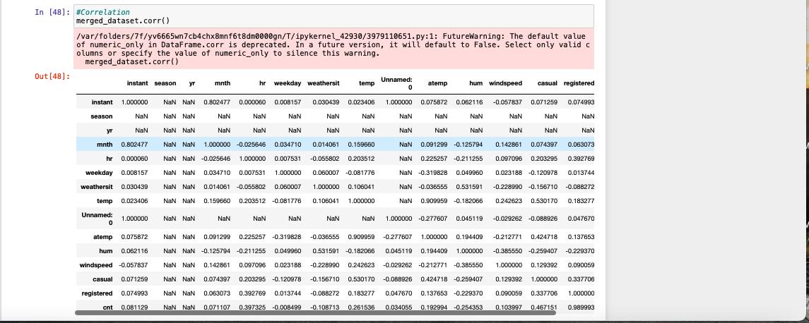
correlation
to check the relationship between two things, which is highly correlated or less correlated

Slide 10
Thanks

